Slide 1

Email Order Processing Automation RPA
Sakka Mohamad-Mario
Zafar Azzam
Al-Khalidy Essam
Mahmoud Abdelrahman
Notes:
Welcome the audience and introduce the project title as Email Order Processing Automation.
Explain that the goal is to transform manual, repetitive tasks into a streamlined digital workflow.
State that the solution is built entirely on a local stack using UiPath, Outlook, and Microsoft Excel.
Introduce the team members Mohamad Mario, Abdelrahman, Azzam, and Essam who contributed to the project.

Slide 2

The Problem: Manual Bottlenecks
Manual order processing creates significant operational challenges that hinder business growth and efficiency:
High manual effort required for reading emails and extracting data.
Accuracy risks associated with manual data entry into Excel sheets.
Traceability gaps in tracking processed orders and attachments.
Response delays for high-value orders due to manual queues.
Notes:
“Today, manual order processing is a major bottleneck for the business.”
“We spend too much time opening emails and manually extracting order data.”
“Copying into Excel creates errors — typos, missed lines, wrong quantities.”
“There’s little traceability, so tracking order history is difficult and slow.”
“And in a busy inbox, high-priority orders get buried and responses get delayed.”
“So the impact is speed, accuracy, visibility, and customer responsiveness.”

Slide 3

The Solution: Automated Processing
A robust RPA-based automation framework designed to transform manual email order handling into a seamless, local workflow:
Automated detection of order emails using keywords.
Reliable extraction from Labeled, CSV, and Pipe formats.
Instant updates to the local restock spreadsheet.
Intelligent routing to Processed or Priority folders.
Notes:
“Now let’s look at the solution: a robust RPA framework that automates the full order lifecycle end-to-end.”
“The bot continuously monitors the inbox and instantly detects new orders by scanning for specific keywords.”
“It then extracts the order details flexibly — whether the content is labeled text, a CSV attachment, or a pipe-delimited format.”
“As soon as the data is captured, it updates the local restock spreadsheet immediately, so inventory stays current.”
“And finally, it automatically sends a confirmation email, so customers get instant feedback that their order was received and processed.”

Slide 4

Implementation Approaches
Our RPA Solution: Focuses on "Surface Integration" using UiPath to work with the software you already have, such as Outlook Classic and Excel, without needing to change them.
API-Based Integration: Requires software to have "open doors" or APIs to communicate, which tools like Zapier, Make.com, or Power Automate Cloud use, but many local or older desktop versions do not support these connections.
Outsourced Portals: Moves the work to a third-party website like SAP Ariba, Coupa, or Oracle NetSuite, which takes the data out of your direct control and adds recurring subscription costs.
Custom Middleware: Involves building separate "bridge" software using platforms like MuleSoft, IBM App Connect, or Custom Python Scripts, which is expensive to develop and requires a dedicated IT team to maintain.
Notes:
“This slide compares the main ways companies implement automation — and why the approach matters.”
“Our RPA solution is about meeting the business where it is — we automate the tools you already use, like Outlook Classic and Excel, without forcing a migration.”
“API-based tools like Zapier or Power Automate are popular, but they often struggle with local desktop versions, locked environments, or custom Excel macros.”
“Outsourced portals like Ariba or Coupa can work, but they’re expensive — and they force customers to use a separate system just to place an order.”
“Custom middleware or EDI is what large enterprises do, but it usually means a big IT budget and months of setup and maintenance.”
“The key advantage of RPA is that it can act across disconnected desktop apps like a human — not just detect patterns.”
“So overall, RPA gives the best balance of automation power, local security, and low cost.”

Slide 5
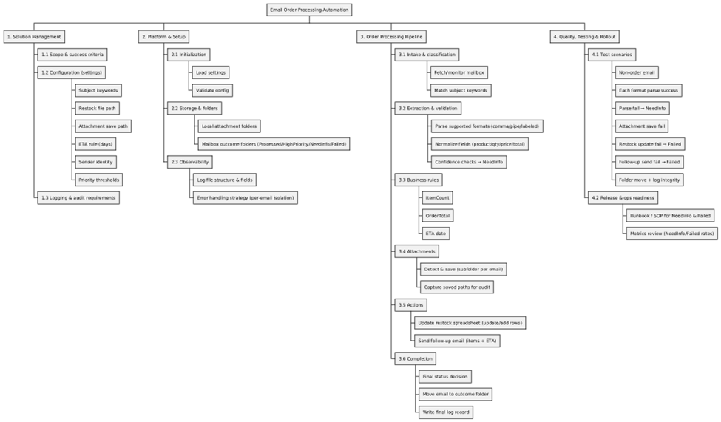

Slide 6
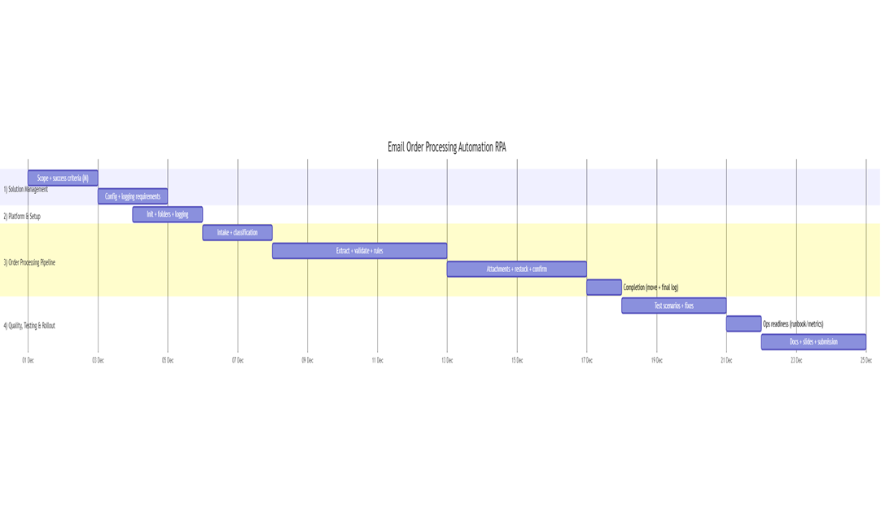

Slide 7
Operational Requirements
OR1 The solution shall operate on a Windows 10+ workstation with Outlook Classic and Microsoft Excel installed.
OR2 The solution shall process a configured Outlook mailbox account and shall send follow up emails from the same account.
OR3 The solution shall run on a daily schedule configured by the operator. The default run time is 23:45.
OR4 The solution shall process at most 50 emails per run by default and shall allow this value to be configured.
OR5 The solution shall process only unread emails by default and shall allow this behavior to be configured.
Notes:
“This slide compares the main ways companies implement automation — and why the approach matters.”
“Our RPA solution is about meeting the business where it is — we automate the tools you already use, like Outlook Classic and Excel, without forcing a migration.”
“API-based tools like Zapier or Power Automate are popular, but they often struggle with local desktop versions, locked environments, or custom Excel macros.”
“Outsourced portals like Ariba or Coupa can work, but they’re expensive — and they force customers to use a separate system just to place an order.”
“Custom middleware or EDI is what large enterprises do, but it usually means a big IT budget and months of setup and maintenance.”
“The key advantage of RPA is that it can act across disconnected desktop apps like a human — not just detect patterns.”
“So overall, RPA gives the best balance of automation power, local security, and low cost.”

Slide 8
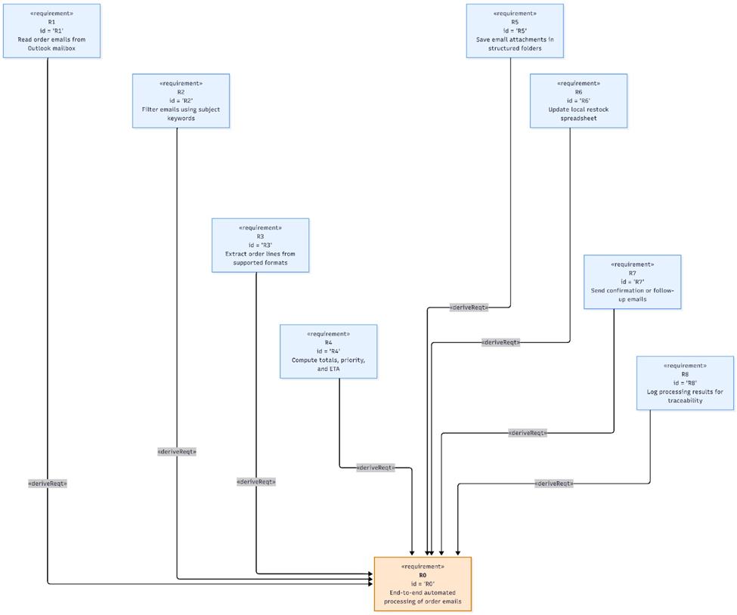
Functional Requirements
FR0 End-to-end automated processing of order emails
FR1 Read order emails from Outlook mailbox
FR2 Filter emails using subject keywords
FR3 Extract order lines from supported formats
FR4 Compute totals, priority, and ETA
FR5 Save email attachments in structured folders
FR6 Update local restock spreadsheet
FR7 Send confirmation or follow-up emails
Notes:
“This slide compares the main ways companies implement automation — and why the approach matters.”
“Our RPA solution is about meeting the business where it is — we automate the tools you already use, like Outlook Classic and Excel, without forcing a migration.”
“API-based tools like Zapier or Power Automate are popular, but they often struggle with local desktop versions, locked environments, or custom Excel macros.”
“Outsourced portals like Ariba or Coupa can work, but they’re expensive — and they force customers to use a separate system just to place an order.”
“Custom middleware or EDI is what large enterprises do, but it usually means a big IT budget and months of setup and maintenance.”
“The key advantage of RPA is that it can act across disconnected desktop apps like a human — not just detect patterns.”
“So overall, RPA gives the best balance of automation power, local security, and low cost.”

Slide 9
Non-Functional Requirements
NFR1 (Performance): ≤ 30s per email (normal conditions).
NFR2 (Reliability): ≥ 95% successful runs (no crashes).
NFR3 (Traceability): CSV log with timestamp, order ID, final status folder, attachment path.
NFR4 (Data minimization): No full email body stored; log only metadata.
NFR5 (Access control): Files stored in restricted local directory (robot user + optional admin only).
NFR6 (Maintainability): Settings editable via settings form (no workflow edits).
Notes:
“This slide compares the main ways companies implement automation — and why the approach matters.”
“Our RPA solution is about meeting the business where it is — we automate the tools you already use, like Outlook Classic and Excel, without forcing a migration.”
“API-based tools like Zapier or Power Automate are popular, but they often struggle with local desktop versions, locked environments, or custom Excel macros.”
“Outsourced portals like Ariba or Coupa can work, but they’re expensive — and they force customers to use a separate system just to place an order.”
“Custom middleware or EDI is what large enterprises do, but it usually means a big IT budget and months of setup and maintenance.”
“The key advantage of RPA is that it can act across disconnected desktop apps like a human — not just detect patterns.”
“So overall, RPA gives the best balance of automation power, local security, and low cost.”

Slide 10

Physical Requirements
PR1: Host runs windows 10+
PR2: Host has stable Outlook mailbox access via installed Outlook client.
PR3: Host has read/write permissions for attachments folder, restock file, and orders log paths.
PR4: Host has Microsoft Excel installed for spreadsheet updates.
Notes:
“This slide compares the main ways companies implement automation — and why the approach matters.”
“Our RPA solution is about meeting the business where it is — we automate the tools you already use, like Outlook Classic and Excel, without forcing a migration.”
“API-based tools like Zapier or Power Automate are popular, but they often struggle with local desktop versions, locked environments, or custom Excel macros.”
“Outsourced portals like Ariba or Coupa can work, but they’re expensive — and they force customers to use a separate system just to place an order.”
“Custom middleware or EDI is what large enterprises do, but it usually means a big IT budget and months of setup and maintenance.”
“The key advantage of RPA is that it can act across disconnected desktop apps like a human — not just detect patterns.”
“So overall, RPA gives the best balance of automation power, local security, and low cost.”

Slide 11

Quality Assurance
Metric 1 - Order Extraction Accuracy (Result: 97%)
Formula: Accuracy = (# of true order emails where every extracted line is fully correct) / (total # of true order emails processed) Correct only if ProductName, Quantity, UnitPrice match ground truth for all line items.
Data collection scenario: We processed 50 emails. Manually labeled 40 as true order emails. Compared robot output vs labeled ground truth and computed accuracy.
Metric 2 - Fail Rate (Restock File Update) (0%)
Formula: Fail rate = (# of restock file update attempts that failed) / (total # of restock file update attempts)
Data collection scenario: During the same run period, counted every restock update attempt and recorded whether it succeeded or failed; computed fail rate from totals.
Notes:
“This slide is about reliability — the system is designed to be failsafe, with clear exception handling and full logging.”
“If the bot hits an error, it doesn’t stop the whole workflow — the email is isolated into a Failed folder so processing can continue while the issue is investigated.”
“If an order is ambiguous, it’s routed to NeedInfo for manual review, so we never risk losing data or processing the wrong information.”
“On the file side, every attachment is logged and stored in a timestamped subfolder, so we always have the exact input that was processed.”
“And we maintain an Audit Log that records each transaction with a timestamp, status, and outcome — giving us full traceability end-to-end.”
“Finally, before the bot starts, it runs pre-flight checks to confirm file access and that required applications are ready, which prevents avoidable runtime failures.”

Slide 12

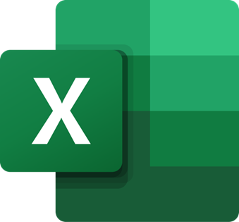
Implementation: Local Automation Stack
The system leverages a robust, local technology stack to ensure high performance, security, and seamless integration with existing desktop tools.
UiPath Studio: The core engine used to build modular and stable automation sequences.
Outlook Classic: Direct local integration for fetching unread order emails and routing.
Microsoft Excel: Local storage and management of the restock spreadsheet and audit logs.
Local Security: All data processing and storage remain on the workstation for maximum control.
Notes:
“Here we’re using a local-first architecture — we chose it for speed, reliability, and data security, because sensitive order data never needs to leave the workstation.”
“At the core is UiPath Studio, which we use to build modular, stable automation sequences that are easy to maintain and extend.”
“The bot integrates directly with Outlook Classic on the desktop, so it can monitor the inbox, read unread orders, and route emails without relying on cloud connectors.”
“For tracking, Microsoft Excel acts as the local database — it stores the restock sheet and also keeps audit logs so we can trace what happened for every order.”
“And the key point is: all processing runs locally on a Windows 11 machine — so there’s zero cloud dependency and maximum control over data.”

Slide 13

Business Logic: Priority & Routing
The system applies deterministic rules to categorize orders and manage email workflow automatically.
HighPriority is assigned when order totals exceed the "Fast Delivery" price threshold.
Standard status is the default for all other valid, parseable orders.
NeedInfo routing flags ambiguous orders for manual review to prevent data loss.
Outcome folders ensure clear separation between processed, high priority, and manual review items.
Notes:
“This slide is about the business logic — we use deterministic rules so high-value orders automatically get prioritized, every time.”
“First, we classify an order as HighPriority when the order total exceeds a defined price threshold — that’s how we fast-track urgent, high-value requests.”
“Everything else that’s valid and clearly parseable is treated as Standard and processed normally.”
“If something is unclear or incomplete, it’s flagged as NeedInfo and routed for manual review so we don’t risk bad data entering the system.”
“Then we enforce it operationally with folder routing: emails are automatically sorted into Processed, Priority, or Manual Review folders.”
“The outcome is simple: no order gets lost, and the most valuable orders consistently receive the fastest attention.”

Slide 14
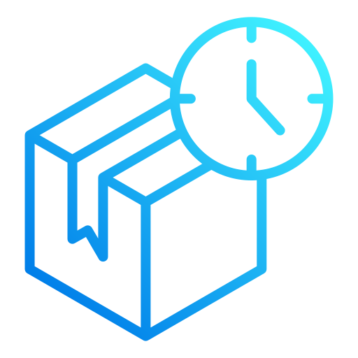
Business Logic: Delivery & ETA
The system automatically computes delivery estimates to provide customers with accurate and timely order fulfillment information.
Fast Delivery: Today plus Fast days (applied to all high priority orders).
Slow Delivery: Today plus Slow days (applied to orders with high item quantities).
Standard Delivery: Today plus Slow days (applied to orders with high item quantities).
Automated Communication: Estimates are included in the instant email reply sent to the customer.
Notes:
“This slide covers delivery and ETA — the goal is transparency, so customers immediately know when to expect fulfillment.”
“The system automatically calculates the ETA by taking today’s date and applying a delivery rule based on the order type.”
“For Fast Delivery, which applies to priority orders, we add a shorter lead time — so high-priority customers get a faster estimated date.”
“For Slow Delivery, we trigger a longer lead time when item quantities are high, to manage expectations realistically.”
“Those ETAs are then automatically inserted into the confirmation email, so the customer gets the estimate instantly without anyone writing it manually.”
“The result is consistent, accurate communication — and that builds customer trust because updates are fast and predictable.”

Slide 15

Reliability: Exception Handling
The system ensures data integrity and operational continuity through intelligent exception management and comprehensive logging.
NeedInfo Routing: Flagging ambiguous orders for manual review.
Failed Folder: Isolating system errors for immediate troubleshooting.
Outcome Folders: Clear separation between Processed and Priority items.
Audit Logs: Local CSV recording of every transaction for traceability.
Notes:
“This slide is about reliability — the system is designed to be failsafe, with clear exception handling and full logging.”
“If the bot hits an error, it doesn’t stop the whole workflow — the email is isolated into a Failed folder so processing can continue while the issue is investigated.”
“If an order is ambiguous, it’s routed to NeedInfo for manual review, so we never risk losing data or processing the wrong information.”
“On the file side, every attachment is logged and stored in a timestamped subfolder, so we always have the exact input that was processed.”
“And we maintain an Audit Log that records each transaction with a timestamp, status, and outcome — giving us full traceability end-to-end.”
“Finally, before the bot starts, it runs pre-flight checks to confirm file access and that required applications are ready, which prevents avoidable runtime failures.”

Slide 16

Future Potential: Scaling & Enhancements
The project roadmap focuses on expanding system capabilities and transitioning to more robust data management architectures.
Multi-Format Expansion: Adding support for PDF attachments and more diverse email layouts.
Advanced Analytics: Generating local reports on order trends and processing efficiency from audit logs.
Database Transition: Moving from Excel to a local SQLite database for improved data integrity and concurrency.
Audit Logs: Real-time checks against product availability and customer account status.
Notes:
“To close, this slide shows the roadmap — how we can scale the system beyond the current implementation.”
“First, we plan to expand input support by adding OCR, so the bot can process PDF attachments and even scanned order forms.”
“Second, we can build local analytics dashboards from the audit logs — so we can track order volume, processing time, exception rates, and overall efficiency.”
“Third, as usage grows, we can transition from Excel to a local SQLite database to improve data integrity, concurrency, and long-term maintainability.”
“And because the solution is modular, we can also add real-time inventory checks as a future integration — so validation happens automatically during processing.”

Slide 17
Demo Time
Notes:
“To wrap up, the core benefits are simple: we improve efficiency, reduce errors, and increase reliability through automation.”
“This is professional-grade RPA that runs locally — on a standard desktop — so we get strong performance and control with zero cloud dependency.”
“Thank you for your time — I’ll stop here and open it up for questions.”
“And if it helps, I’m happy to go deeper on the technical implementation, the business logic, or why we chose a local-first approach.”

Slide 18
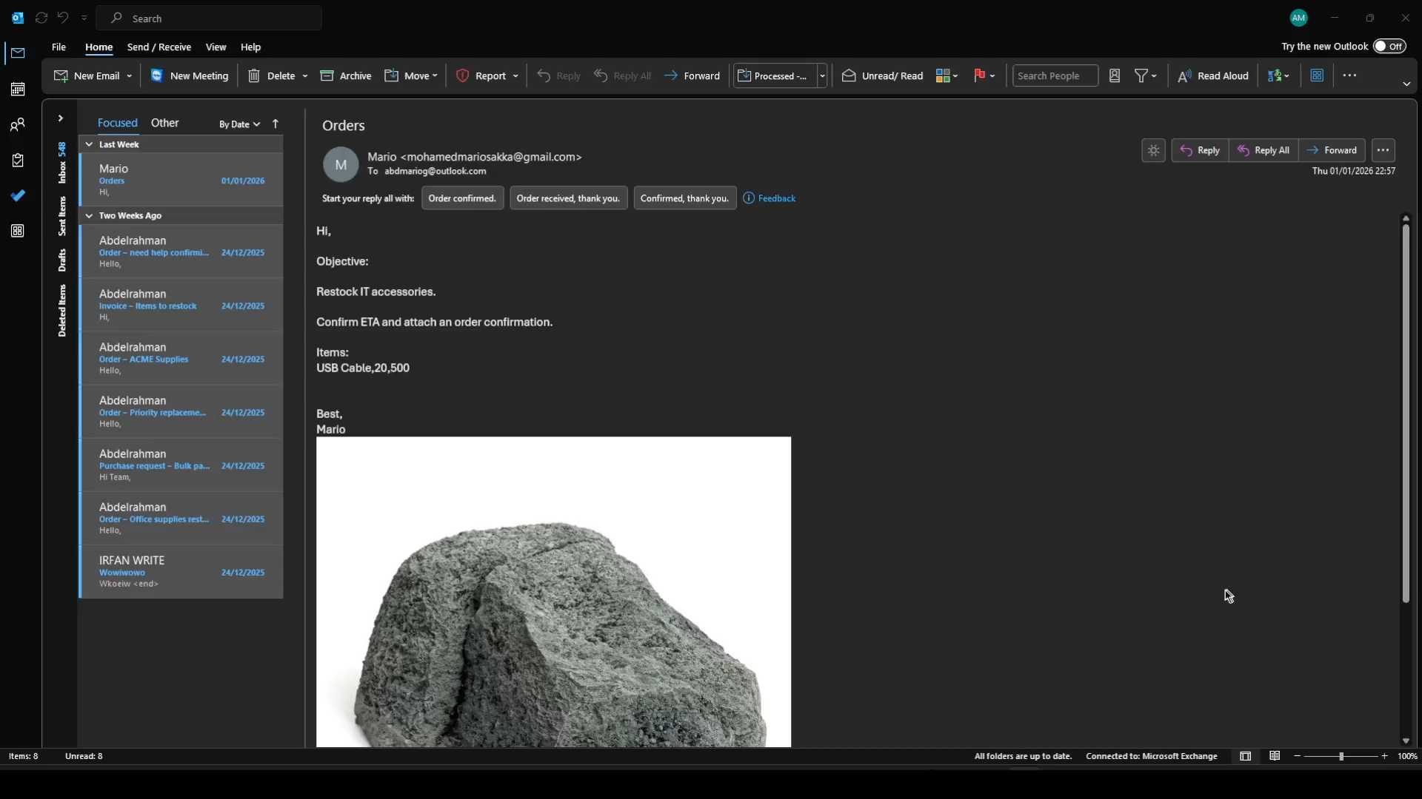

Slide 19
Thank You!
Questions & Answers
Notes:
“To wrap up, the core benefits are simple: we improve efficiency, reduce errors, and increase reliability through automation.”
“This is professional-grade RPA that runs locally — on a standard desktop — so we get strong performance and control with zero cloud dependency.”
“Thank you for your time — I’ll stop here and open it up for questions.”
“And if it helps, I’m happy to go deeper on the technical implementation, the business logic, or why we chose a local-first approach.”

